Slide 1

Data Scientist Co-Op Case Study
Cohere Pets Case Study
Presenter Name: Jani Miya Shaik Date: 27th October 2024

Slide 2
Table of contents
07
08
Introduction to the problem
Problem Overview
Data Overview
Data Preprocessing
Feature Engineering
Feature Selection Process
Modeling Approach
Hyperparameter Tuning and Cross-Validation
09 Model Evaluation and Metrics
₁₀ Operational Benefits of Model Integration
Conclusion and Next Steps
11

Slide 3


Introduction
Prior authorization is a common hurdle in pet medical care, often causing delays in treatment. This project aims to address this issue by streamlining the approval process, enhancing efficiency in veterinary practices, and ultimately improving patient care for pets.

Slide 4





Problem Overview!

Slide 5
Objective:
Create a predictive model to auto-approve or deny prior authorization requests for pet medical procedures.
Business Need:
Automate the approval process, reduce manual review workload, and increase efficiency.
Challenges:
Ensuring high accuracy to avoid incorrect approvals or denials, handling unbalanced data, and selecting relevant features.

Slide 6

Data Overview

Slide 7
Datasets Used:
Features Explored:
Categorical: Service type, pet type, reviewer.
Temporal: Day of the week and hour of submission.
Numerical: Claim history data.
Target Variable: auto_approved (Yes/No)
Prior Authorizations: Information on each authorization request
Claims Data: Details or Previous Claims linked to these requests

Slide 8

Data Preprocessing

Slide 9

Missing Value Treatment:
Filled missing values with Median or Mode where data was unavailable.
Encoding Categorical Variables:
Used Label Encoding for categorical features (service type, pet type, reviewer).
Class Imbalance Handling:
Applied SMOTE (Synthetic Minority Over- sampling Technique) to balance the dataset.

Slide 10

Data Visualization

Slide 11
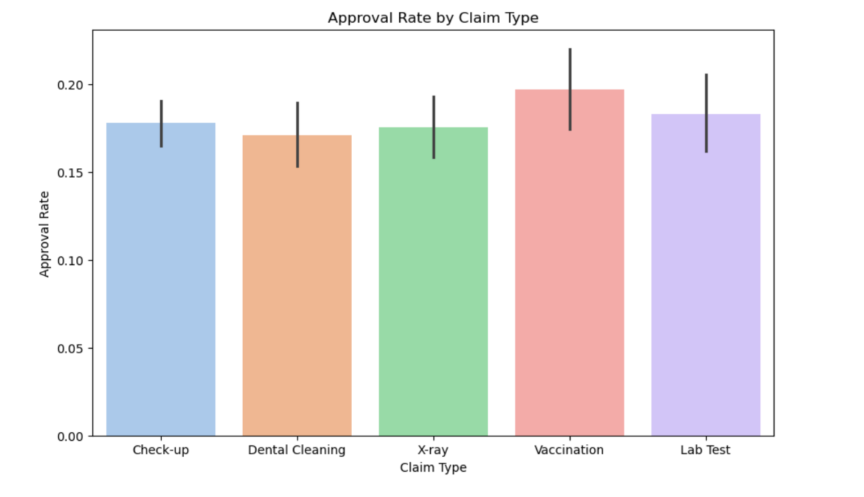
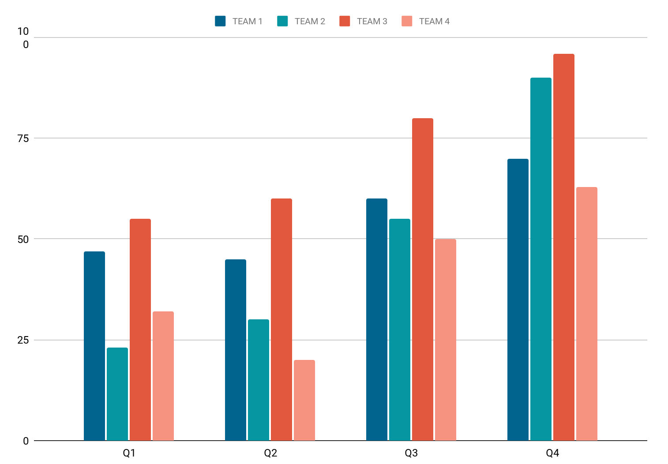
Approval Rate By Claim Type
Team 1
Team 2
Team 3
Team 4
Follow the link in the graph to modify its data and then paste the new one here. For more info, click here

Slide 12
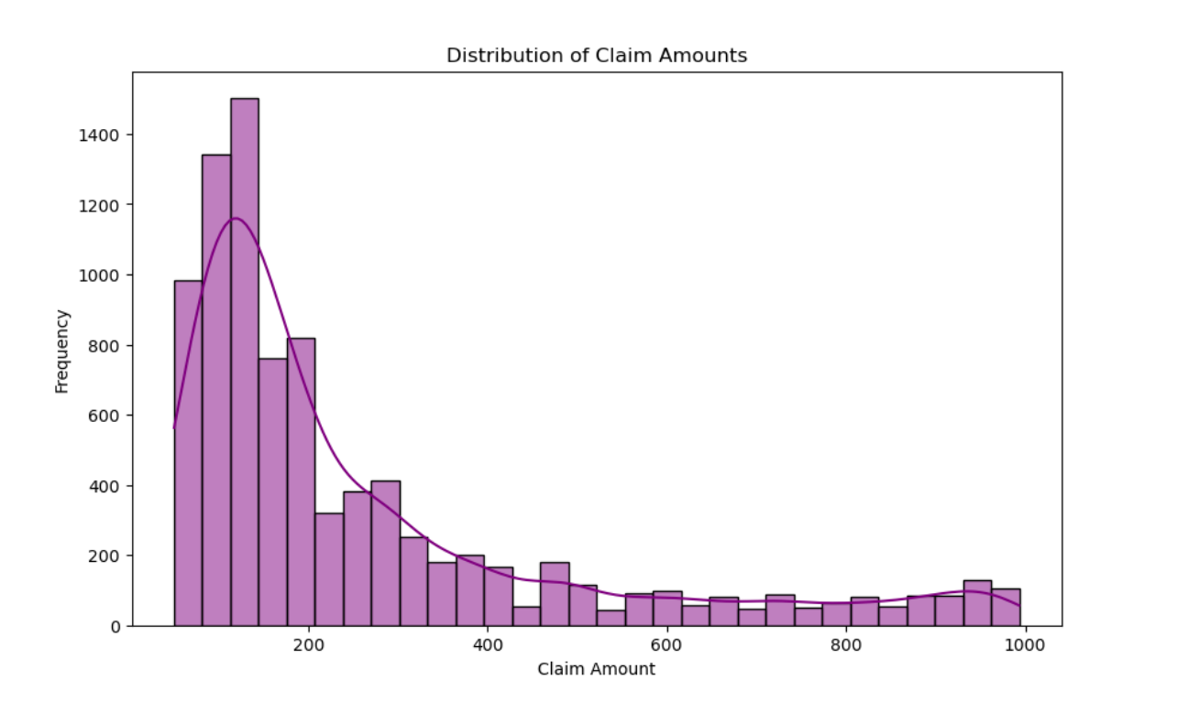
Distribution of Claim Amounts
Team 1
Team 2
Team 3
Team 4
Follow the link in the graph to modify its data and then paste the new one here. For more info, click here

Slide 13
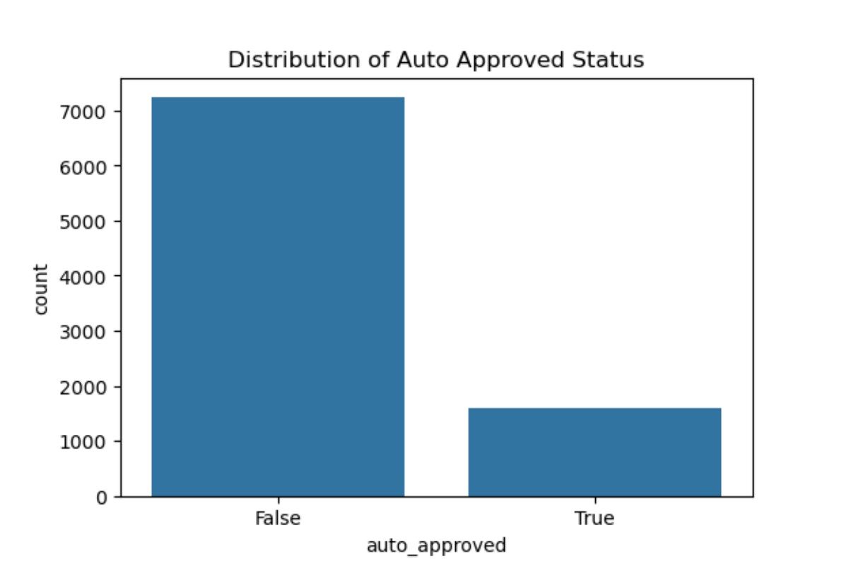
Distribution of Auto Approved Status

Slide 14
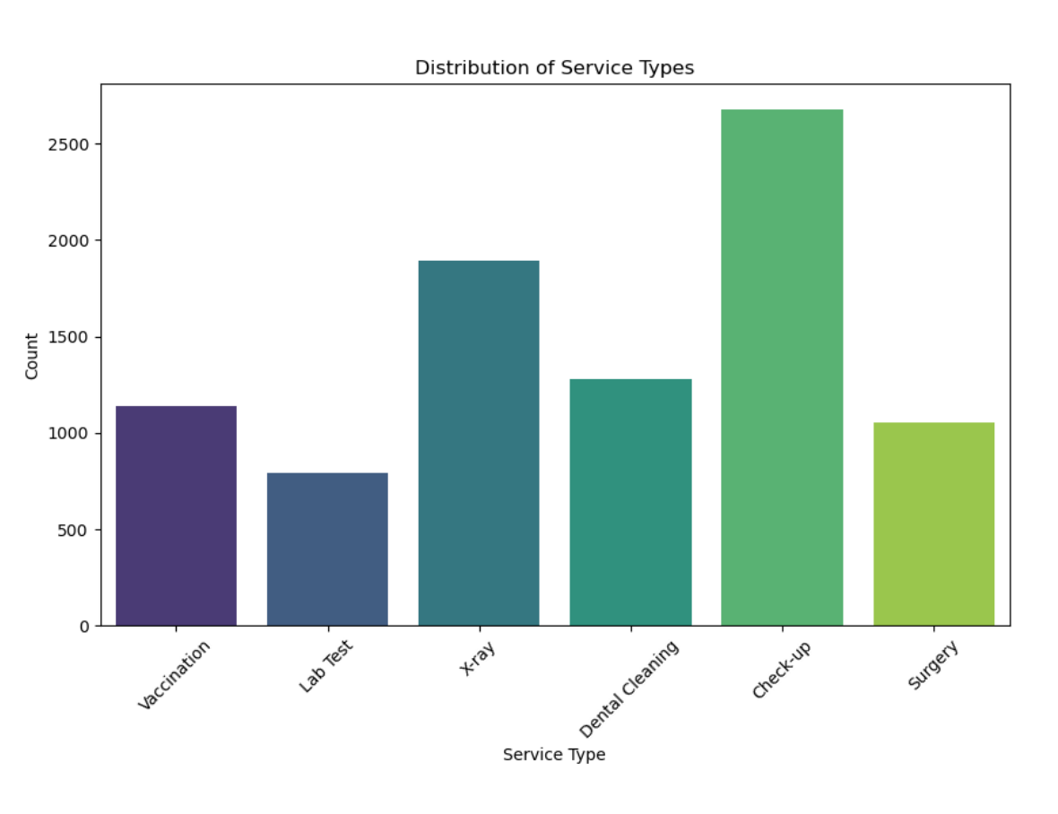
Distribution of Service Types

Slide 15

Feature Engineering

Slide 16

New Features Created:
Extracted day of the week and hour of the day from the submission timestamp.
Objective:
Capture possible patterns related to the timing of requests.
Data Standardization:
Ensured uniform scales across numerical features for better model performance.

Slide 17

Feature Selection
Process

Slide 18


Methodology:
Used Recursive Feature Elimination with Cross-Validation (RFECV) to remove less relevant features.
Goal:
Optimize model accuracy by focusing on the most predictive features.
Results:
Selected features included service type, pet type, and submission timing, which strongly correlated with approval likelihood.

Slide 19
Modeling Approach

Slide 20


Models Tested:
Logistic Regression
Random Forest
XGBoost
Gradient Boosting
Adaboost
Ensemble Model
Reason for Choice:
Logistic Regression: Simple and interpretable, providing insights into feature relationships. Random Forest: Robust performance with large datasets, capturing complex interactions. XGBoost: High performance and flexibility for non-linear relationships, with built-in regularization. Gradient Boosting: Iteratively improves predictions, suitable for complex datasets.
AdaBoost: Focuses on misclassified instances to enhance predictions on difficult cases.
Ensemble Model: Combines models for improved performance and robustness.

Slide 21

Hyperparameter Tuning and Cross-Validation

Slide 22

You can divide the content
Grid Search for Hyperparameters
Ran Grid Search for each model to find optimal parameters.
- Examples of parameters tuned: n_estimators, max_depth, max_iter, min_samples_split and learning_rate
Cross-Validation Scores
Logistic Regression: CV Accuracy = 68.3% Random Forest: CV Accuracy = 83.5% XGBoost: CV Accuracy = 83.4%
Gradient Boosting: CV Accuracy = 84% AdaBoost: CV Accuracy = 70.1% Ensemble Model: CV Accuracy = 82.7%
Selected the best model with the highest CV accuracy

Slide 23
Model Evaluation Metrics

Slide 24
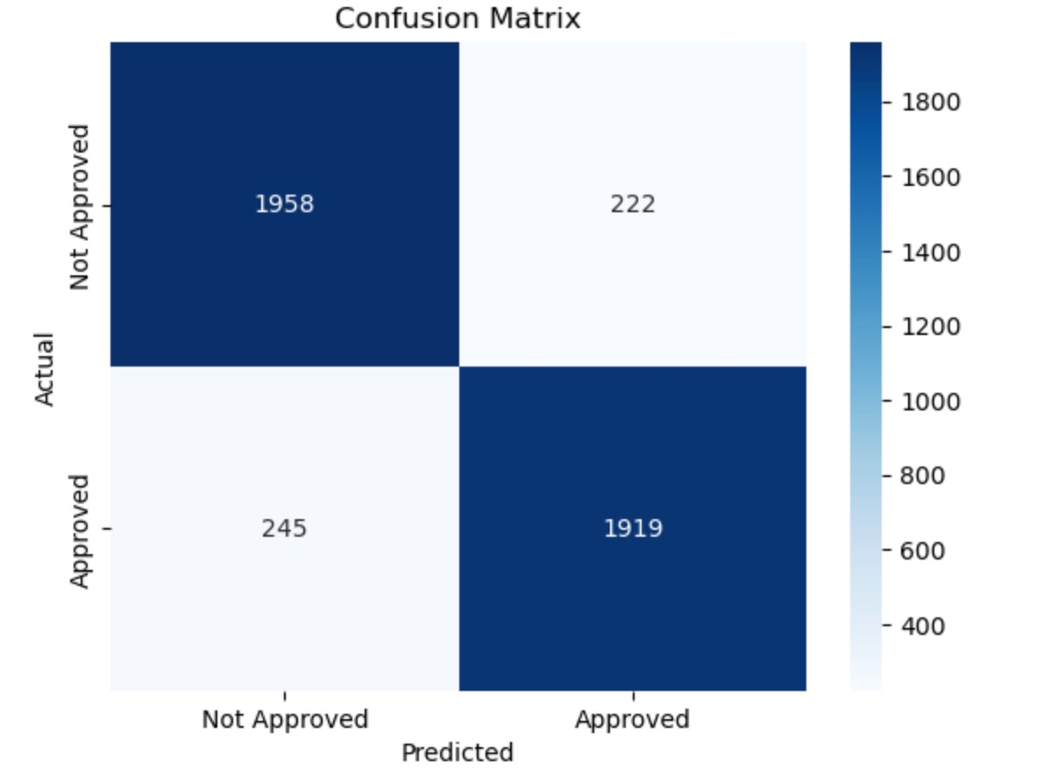
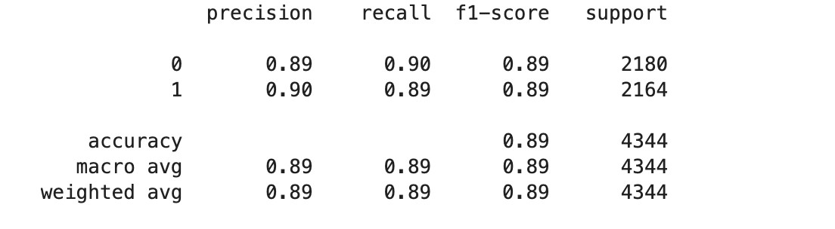
Confusion Matrix
Accuracy Score
Precision and Recall
Demonstrated the performance on actual vs. predicted values
Measured the overall performance
Evaluated how well the model distinguishes between approvals and denials.
Test Set Accuracy: 89.25 %

Slide 25


Operational Benefits of Model Integration

Slide 26
Efficiency Gains:
Reduced workload for human reviewers.
Faster processing times for approval requests.
Scalability:
Model can handle increasing data volumes with minor re-training efforts.
Cost Savings:
Automated approvals streamline the workflow, saving time and resources.

Slide 27

Next Steps
1. Model Deployment:
- Integrate the model into the auto-approval pipeline.
2. Monitoring:
- Continuous model monitoring and performance updates.
3. User Feedback Loop:
- Incorporate user feedback to address edge cases and optimize further.

Slide 28


Thanks!
Do you have any questions? janimiyask72@gmail.com
+1 6194169394
https://github.com/janimiyarj/MyProfile https://www.linkedin.com/in/jani-miya-shaik/
CREDITS: This presentation template was created by Slidesgo, and includes icons by Flaticon, and infographics & images by Freepik

